Slide 1
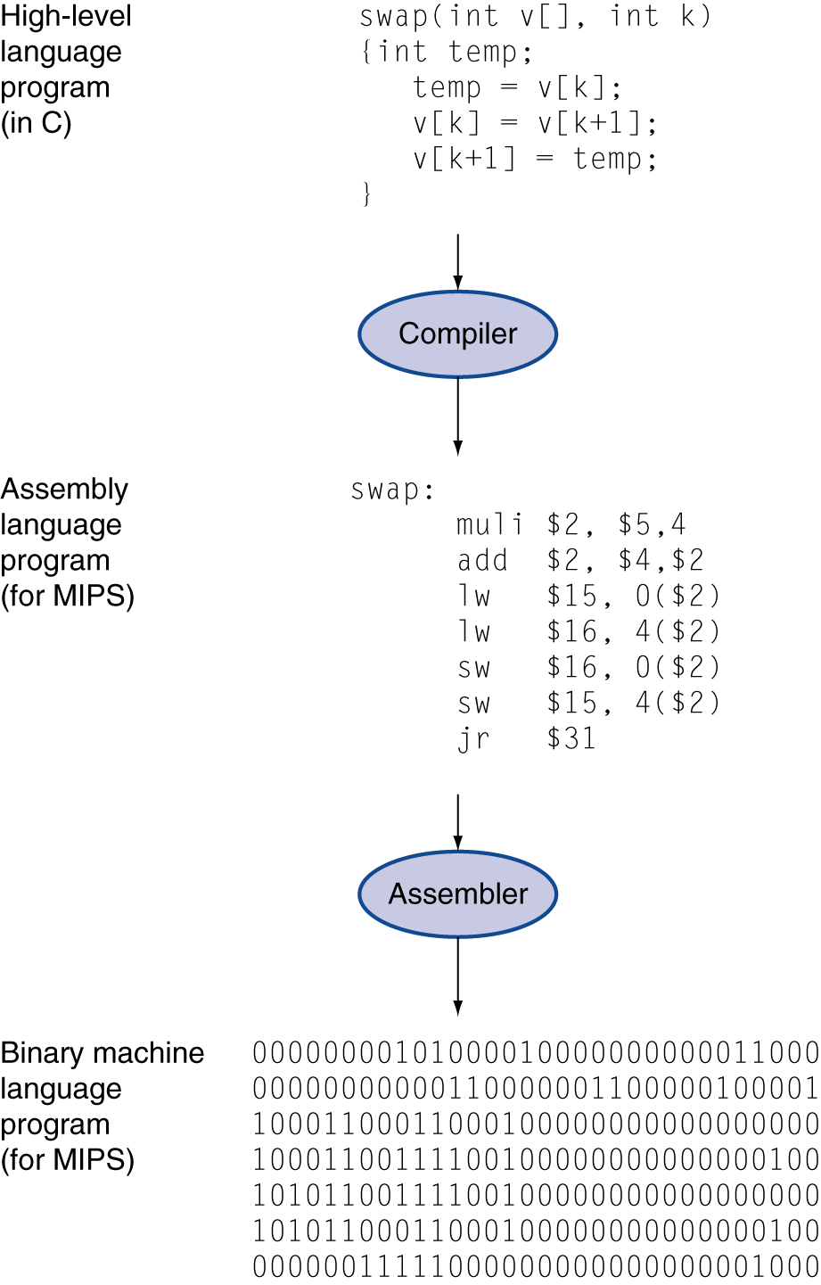
Instructions: Language of the Computer
CSE301
Spring 2020
Jongeun Lee
School of ECE, UNIST

Slide 2
Key Points

Slide 3
Register Operands
Arithmetic instructions use register operands
MIPS has a 32 × 32-bit register file
Use for frequently accessed integer data
Numbered 0 to 31
32-bit data called a “word”
Assembler names (vary depending on assembler)
$0, $1, …, $31
r0, r1, …, r31 (case-insensitive)
Alternative naming scheme
$t0, $t1, …, $t9: $8 ~ $15 (for temporary values)
$s0, $s1, …, $s7: $16 ~ $23 (for variables that live across function calls)
§2.3 Operands of the Computer Hardware

Slide 4
Register Operand Example
C code:
f = (g + h) - (i + j);
f, …, j in $s0, …, $s4
Compiled MIPS code:
add $t0, $s1, $s2 add $t1, $s3, $s4 sub $s0, $t0, $t1

Slide 5
Memory Operand Example 1
C code:
g = h + A[8];
g in $s1, h in $s2, base address of A in $s3
Compiled MIPS code:
Index 8 requires offset of 32
4 bytes per word
lw $t0, 32($s3) # load word add $s1, $s2, $t0
offset
base register

Slide 6
Memory Operand Example 2
C code:
A[12] = h + A[8];
h in $s2, base address of A in $s3
Compiled MIPS code:
Index 8 requires offset of 32
lw $t0, 32($s3) # load word add $t0, $s2, $t0 sw $t0, 48($s3) # store word

Slide 7
Registers vs. Memory
Registers are faster to access than memory
Operating on memory data requires loads and stores
More instructions to be executed
Compiler must use registers for variables as much as possible
Only spill to memory for less frequently used variables
Register optimization is important!

Slide 8
Memory Operands
Main memory used for composite data
Arrays, structures, dynamic data
To apply arithmetic operations
Load values from memory into registers
Store result from register to memory
Memory is byte addressed
Each address identifies an 8-bit byte
Words are aligned in memory (word-aligned)
Address must be a multiple of 4
MIPS is Big Endian
MSB at the least address of a word
c.f. Little Endian: LSB at the least address

Slide 9
Immediate Operands
Constant data specified in an instruction
addi $s3, $s3, 4
No subtract immediate instruction
Just use a negative constant
addi $s2, $s1, -1

Slide 10
The Constant Zero
MIPS register 0 ($0 = r0 = $zero) is the constant 0
Cannot be overwritten
Useful for common operations
E.g., move between registers
add $t2, $s1, $zero

Slide 11
Design Principles
Design Principle 1: Simplicity favors regularity
Regularity makes implementation simpler
Simplicity enables higher performance at lower cost
Design Principle 2: Smaller is faster
c.f. main memory: millions of locations
Design Principle 3: Make the common case fast
Small constants are common
Immediate operand avoids a load instruction

Slide 12
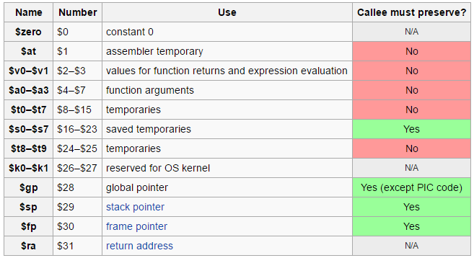
MIPS Register Convention

Slide 13
Conditionals

Slide 14
Conditional Operations
Branch to a labeled instruction if condition is true
Otherwise, continue sequentially
beq rs, rt, L1
if (rs == rt), branch to instruction labeled L1
bne rs, rt, L1
if (rs != rt), branch to instruction labeled L1
j L1
unconditional jump to instruction labeled L1
§2.7 Instructions for Making Decisions

Slide 15
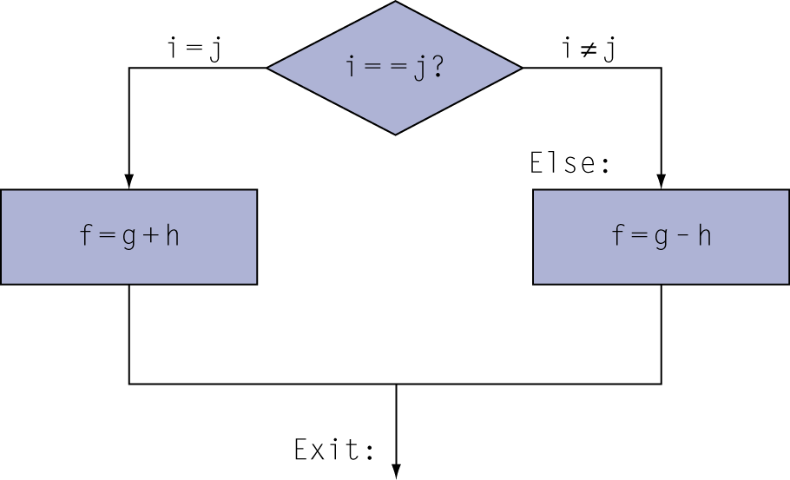
Compiling If Statements
C code:
if (i==j) f = g+h; else f = g-h;
f, g, … in $s0, $s1, …
Compiled MIPS code:
bne $s3, $s4, Else add $s0, $s1, $s2 j Exit Else: sub $s0, $s1, $s2 Exit: …
Assembler calculates addresses

Slide 16
Compiling Loop Statements
C code:
while (save[i] == k) i += 1;
i in $s3, k in $s5, address of save in $s6
Compiled MIPS code:
Loop: sll $t1, $s3, 2 add $t1, $t1, $s6 lw $t0, 0($t1) bne $t0, $s5, Exit addi $s3, $s3, 1 j Loop Exit: …

Slide 17
More Conditional Operations
Set result to 1 if a condition is true
Otherwise, set to 0
slt rd, rs, rt
if (rs < rt) rd = 1; else rd = 0;
slti rt, rs, constant
if (rs < constant) rt = 1; else rt = 0;
Use in combination with beq, bne
slt $t0, $s1, $s2 # if ($s1 < $s2)
bne $t0, $zero, L # branch to L

Slide 18
Branch Instruction Design
Why not: blt, bge, …?
Hardware for <, ≥, … slower than =, ≠
Combining with branch involves more work per instruction, requiring a slower clock
All instructions are penalized!
beq and bne are the common case
This is a good design compromise

Slide 19
Instruction Encoding

Slide 20
Representing Instructions
Instructions are encoded in binary
Called machine code
MIPS instructions
Encoded as 32-bit instruction words
Small number of formats
Regularity!
Register numbers
$t0 – $t7 are $8 – $15
$s0 – $s7 are $16 – $23
$t8 – $t9 are $24 – $25
§2.5 Representing Instructions in the Computer

Slide 21
MIPS I-format Instructions
op
rs
rt
constant or address
6 bits
5 bits
5 bits
16 bits
Immediate arithmetic and load/store instructions
rt: destination (or source) register number
Constant: –2¹⁵ to +2¹⁵ – 1
Address: offset added to base address in rs
Design Principle 4: Good design demands good compromises
Different formats complicate decoding, but allow 32-bit instructions uniformly
Keep formats as similar as possible

Slide 22
MIPS R-format Instructions
op
rs
rt
rd
shamt
funct
6 bits
5 bits
5 bits
5 bits
5 bits
6 bits
Instruction fields
op: operation code (opcode)
rs: first source register number
rt: second source register number
rd: destination register number
shamt: shift amount
funct: function code (extends opcode)

Slide 23
R-format Example
op
rs
rt
rd
shamt
funct
6 bits
5 bits
5 bits
5 bits
5 bits
6 bits
add $t0, $s1, $s2
special
$s1
$s2
$t0
0
add
0
17
18
8
0
32
000000
10001
10010
01000
00000
100000
00000010001100100100000000100000₂ = 02324020₁₆

Slide 24
Hexadecimal
Base 16
Compact representation of bit strings
4 bits per hex digit
0 | 0000 | 4 | 0100 | 8 | 1000 | c | 1100
1 | 0001 | 5 | 0101 | 9 | 1001 | d | 1101
2 | 0010 | 6 | 0110 | a | 1010 | e | 1110
3 | 0011 | 7 | 0111 | b | 1011 | f | 1111
Example: 0x eca8 6420
1110 1100 1010 1000 0110 0100 0010 0000

Slide 25
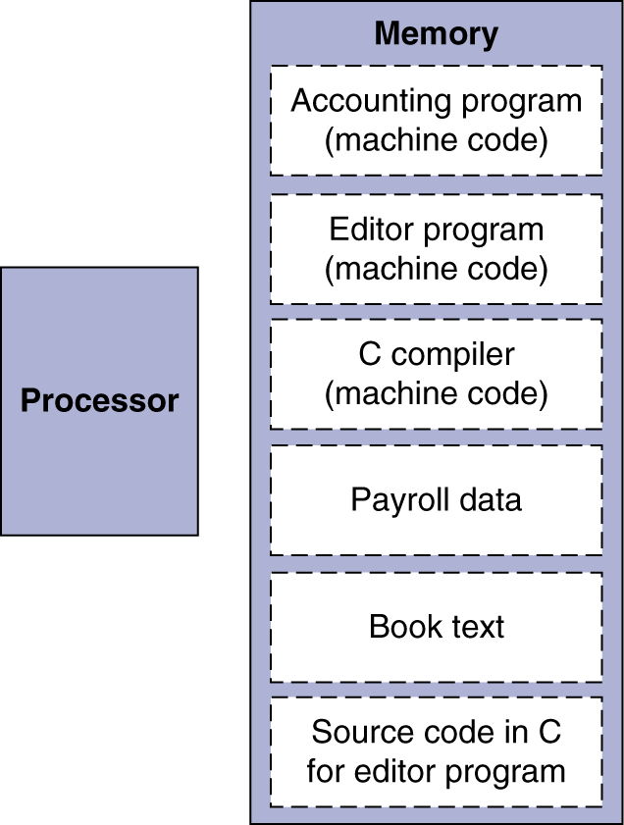
Stored-Program Computers
The BIG Picture
Instructions represented in binary, just like data
Instructions and data stored in memory
Programs can operate on programs
e.g., compilers, linkers, …
Binary compatibility allows compiled programs to work on different computers
Standardized ISAs

Slide 26
Procedure – Leaf

Slide 27
Procedure Calling
Steps required
Place parameters in registers
Transfer control to procedure
Acquire storage for procedure
Perform procedure’s operations
Place result in register for caller
Return to place of call
§2.8 Supporting Procedures in Computer Hardware

Slide 28
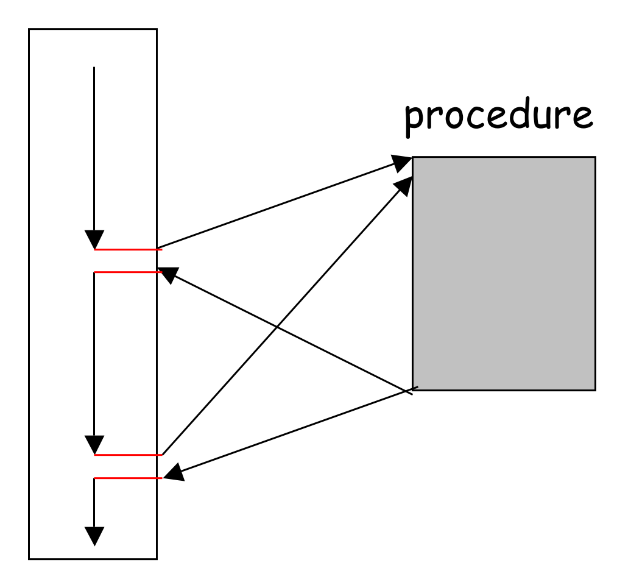
Procedure Call Instructions
Procedure call: jump-and-link
jal ProcedureLabel
Address of following instruction put in $ra
Jumps to target address
Procedure return: jump-on-register
jr $ra
Copies $ra to program counter
Can also be used for computed jumps
e.g., for switch/case statements

Slide 29
Leaf Procedure Example
C code:
int leaf_example (int g, h, i, j)
{
int f; f = (g + h) - (i + j); return f; }
Arguments g, …, j in $a0, …, $a3
f in $s0 (hence, need to save $s0 on stack)
Result in $v0

Slide 30
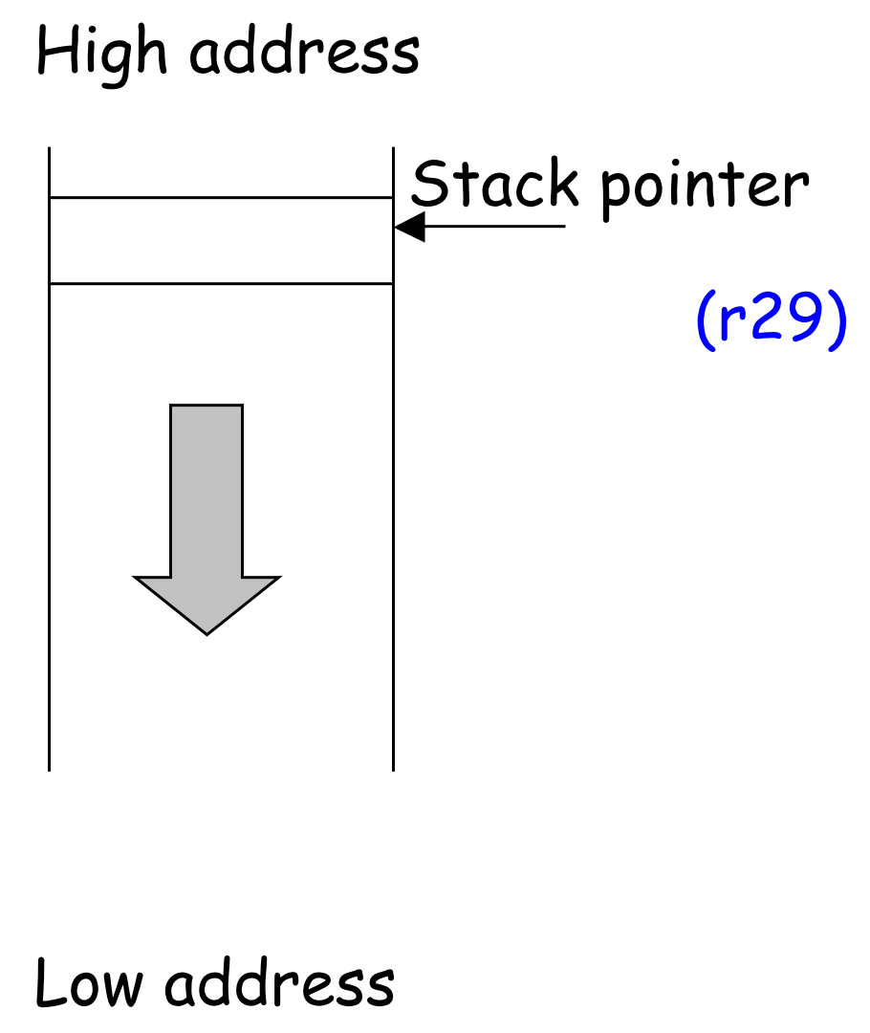
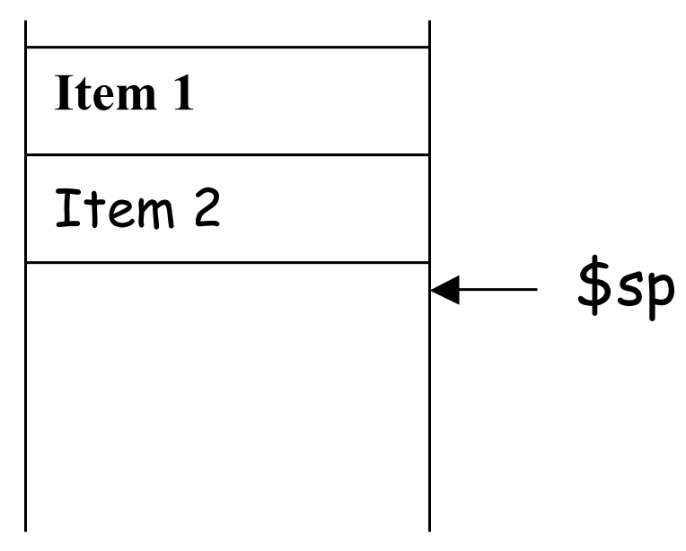
Stack
A part of the main memory
In MIPS it grows from high address to low address
Purely software convention
$sp points to the lowest occupied location
occupied
$sp
occupied
Item 3

Slide 31
Leaf Procedure Example
MIPS code:
leaf_example: addi $sp, $sp, -4 sw $s0, 0($sp) add $t0, $a0, $a1 add $t1, $a2, $a3 sub $s0, $t0, $t1 add $v0, $s0, $zero lw $s0, 0($sp) addi $sp, $sp, 4 jr $ra
Save $s0 on stack
Procedure body
Result
Restore $s0
Return

Slide 32
Procedure – Non-Leaf

Slide 33
Non-Leaf Procedures
Procedures that call other procedures
For nested call, caller needs to save on the stack:
Its return address
Any arguments and temporaries needed after the call
Restore from the stack after the call

Slide 34
Non-Leaf Procedure Example
C code:
int fact (int n)
{
if (n < 1) return f; else return n * fact(n - 1); }
Argument n in $a0
Result in $v0

Slide 35
Non-Leaf Procedure Example
MIPS code:
fact: addi $sp, $sp, -8 # adjust stack for 2 items sw $ra, 4($sp) # save return address sw $a0, 0($sp) # save argument slti $t0, $a0, 1 # test for n < 1 beq $t0, $zero, L1 addi $v0, $zero, 1 # if so, result is 1 addi $sp, $sp, 8 # pop 2 items from stack jr $ra # and return L1: addi $a0, $a0, -1 # else decrement n jal fact # recursive call lw $a0, 0($sp) # restore original n lw $ra, 4($sp) # and return address addi $sp, $sp, 8 # pop 2 items from stack mul $v0, $a0, $v0 # multiply to get result jr $ra # and return

Slide 36
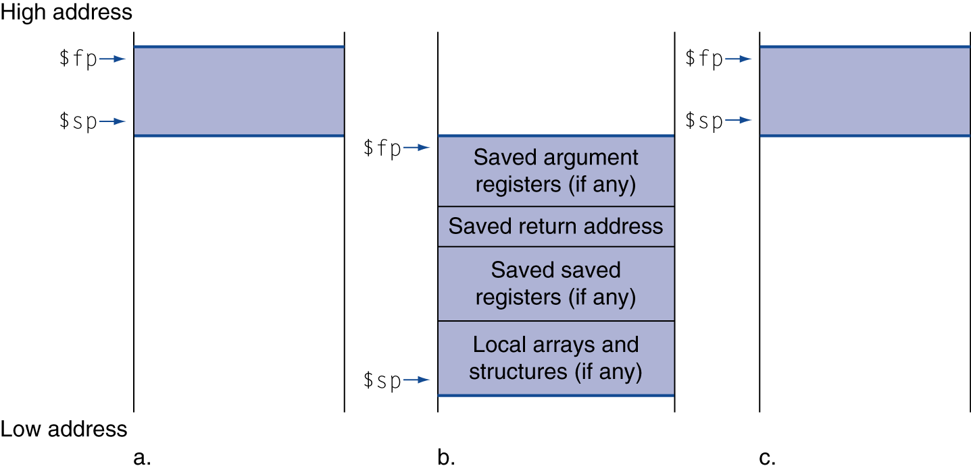
Local Data on the Stack
Local data allocated by callee
e.g., C automatic variables
Procedure frame (activation record)
Used by some compilers to manage stack storage

Slide 37
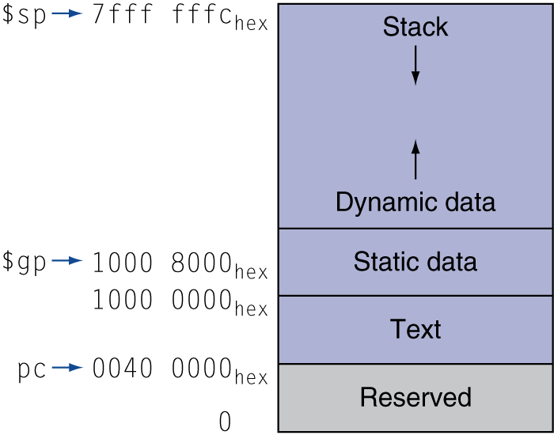
Memory Layout
Text: program code
Static data: global variables
e.g., static variables in C, constant arrays and strings
$gp initialized to address allowing ±offsets into this segment
Dynamic data: heap
E.g., malloc in C, new in Java
Stack: automatic storage

Slide 38
Branch Addressing

Slide 39
Branch Addressing
Branch instructions specify
Opcode, two registers, target address
Most branch targets are near branch
Forward or backward
op
rs
rt
constant or address
6 bits
5 bits
5 bits
16 bits
PC-relative addressing
Target address = PC + offset × 4
PC already incremented by 4 by this time

Slide 40
Jump Addressing
Jump (j and jal) targets could be anywhere in text segment
Encode full address in instruction
op
address
6 bits
26 bits
(Pseudo)Direct jump addressing
Target address = PC_{31…28} : (address × 4)

Slide 41
Target Addressing Example
Loop code from earlier example
Assume Loop at location 80000
Loop: sll $t1, $s3, 2 | 80000 | 0 | 0 | 19 | 9 | 4 | 0
add $t1, $t1, $s6 | 80004 | 0 | 9 | 22 | 9 | 0 | 32
lw $t0, 0($t1) | 80008 | 35 | 9 | 8 | 0
bne $t0, $s5, Exit | 80012 | 5 | 8 | 21 | 2
addi $s3, $s3, 1 | 80016 | 8 | 19 | 19 | 1
j Loop | 80020 | 2 | 20000
Exit: … | 80024

Slide 42
Branching Far Away
If branch target is too far to encode with 16-bit offset, assembler rewrites the code
Example
beq $s0,$s1, L1
↓
bne $s0,$s1, L2 j L1 L2: …

Slide 43
Signed vs Unsigned

Slide 44
Signed vs. Unsigned
Signed comparison: slt, slti
Unsigned comparison: sltu, sltui
Example
$s0 = 1111 1111 1111 1111 1111 1111 1111 1111
$s1 = 0000 0000 0000 0000 0000 0000 0000 0001
slt $t0, $s0, $s1 # signed
–1 < +1 ⇒ $t0 = 1
sltu $t0, $s0, $s1 # unsigned
+4,294,967,295 > +1 ⇒ $t0 = 0

Slide 45
Byte/Halfword Operations
MIPS byte/halfword load/store
String processing is a common case
lb rt, offset(rs) lh rt, offset(rs)
Sign extend to 32 bits in rt
lbu rt, offset(rs) lhu rt, offset(rs)
Zero extend to 32 bits in rt
sb rt, offset(rs) sh rt, offset(rs)
Store just rightmost byte/halfword

Slide 46
Zero vs. Sign Extension
Representing a number using more bits
Preserve the numeric value
Sign extension: Replicate the sign bit to the left
Zero extension (for unsigned values): extend with 0s
Sign extension example: 8-bit to 16-bit
+2: 0000 0010 => 0000 0000 0000 0010
–2: 1111 1110 => 1111 1111 1111 1110
Sign extension in MIPS instruction set
addi: extend immediate value
lb, lh: extend loaded byte/halfword
beq, bne: extend the displacement

Slide 47
Bit-manipulating Instructions

Slide 48
Bit-manipulating Operations
Instructions for bitwise manipulation
§2.6 Logical Operations
Operation | C | Java | MIPS
Shift left | << | << | sll
Shift right | >> | >>> | srl
Bitwise AND | & | & | and, andi
Bitwise OR | | | | | or, ori
Bitwise NOT | ~ | ~ | nor
Useful for extracting and inserting groups of bits in a word

Slide 49
AND Operations
Useful to mask bits in a word
Select some bits, clear others to 0
and $t0, $t1, $t2
$t2
0000 0000 0000 0000 0000 1101 1100 0000
$t1
0000 0000 0000 0000 0011 1100 0000 0000
$t0
0000 0000 0000 0000 0000 1100 0000 0000

Slide 50
OR Operations
Useful to include bits in a word
Set some bits to 1, leave others unchanged
or $t0, $t1, $t2
$t2
0000 0000 0000 0000 0000 1101 1100 0000
$t1
0000 0000 0000 0000 0011 1100 0000 0000
$t0
0000 0000 0000 0000 0011 1101 1100 0000

Slide 51
NOT Operations
Useful to invert bits in a word
Change 0 to 1, and 1 to 0
MIPS provides NOR instruction
a NOR b == NOT ( a OR b )
nor $t0, $t1, $zero
Register 0: always read as zero
$t1
0000 0000 0000 0000 0011 1100 0000 0000
$t0
1111 1111 1111 1111 1100 0011 1111 1111

Slide 52
Shift Operations
op
rs
rt
rd
shamt
funct
6 bits
5 bits
5 bits
5 bits
5 bits
6 bits
shamt: how many positions to shift
Shift left logical
Shift left and fill with 0 bits
sll by i bits is equivalent to multiply-by-2^{i}
Shift right logical
Shift right and fill with 0 bits
srl by i bits is equivalent to divide-by-2^{i} (unsigned only)
Shift right arithmetic (sra)
Shift right and fill with the sign bit
sra by i bits is equivalent to divide-by-2^{i} (both signed and unsigned)

Slide 53
Misc Topics

Slide 54
Assembler Pseudoinstructions
Most assembler instructions represent machine instructions one-to-one
Pseudoinstructions: figments of the assembler’s imagination
move $t0, $t1 → add $t0, $zero, $t1
blt $t0, $t1, L → slt $at, $t0, $t1 bne $at, $zero, L
$at (=$1): assembler temporary

Slide 55
32-bit Constants
Most constants are small
16-bit immediate is sufficient
For the occasional 32-bit constant
lui rt, constant
Copies 16-bit constant to left 16 bits of rt
Clears right 16 bits of rt to 0
§2.10 MIPS Addressing for 32-Bit Immediates and Addresses
lhi $s0, 61
0000 0000 0111 1101 0000 0000 0000 0000
ori $s0, $s0, 2304
0000 0000 0111 1101 0000 1001 0000 0000

Slide 56
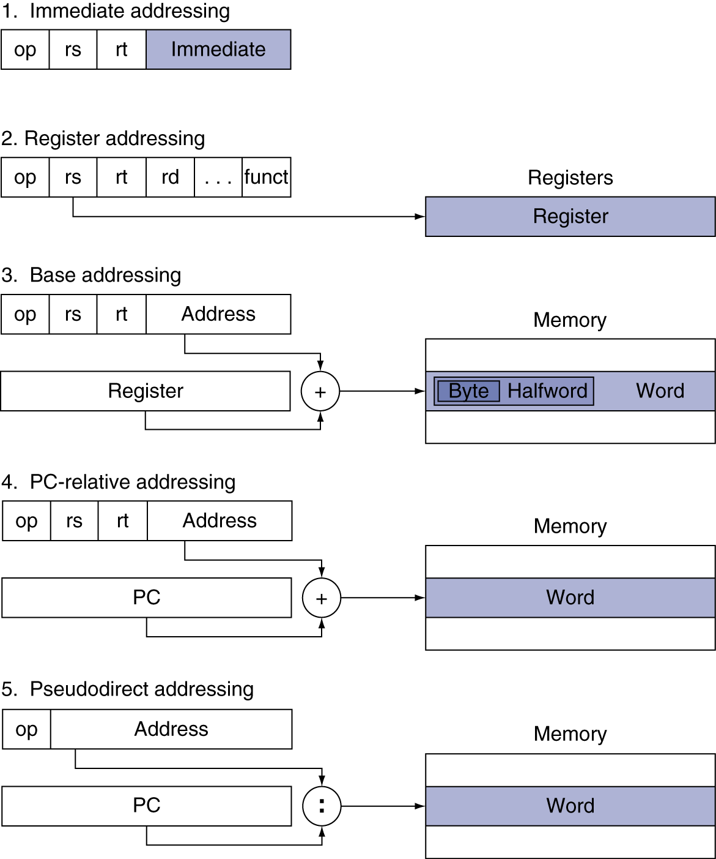
Addressing Mode Summary

Slide 57
Measure MIPS instruction executions in benchmark programs
Consider making the common case fast
Consider compromises
Instruction class | MIPS examples | SPEC2006 Int | SPEC2006 FP
Arithmetic | add, sub, addi | 16% | 48%
Data transfer | lw, sw, lb, lbu, lh, lhu, sb, lui | 35% | 36%
Logical | and, or, nor, andi, ori, sll, srl | 12% | 4%
Cond. Branch | beq, bne, slt, slti, sltiu | 34% | 8%
Jump | j, jr, jal | 2% | 0%

Slide 58
ARM & MIPS Similarities
ARM: the most popular embedded core
Similar basic set of instructions to MIPS
§2.16 Real Stuff: ARM Instructions
 | ARM | MIPS
Date announced | 1985 | 1985
Instruction size | 32 bits | 32 bits
Address space | 32-bit flat | 32-bit flat
Data alignment | Aligned | Aligned
Data addressing modes | 9 | 3
Registers | 15 × 32-bit | 31 × 32-bit
Input/output | Memory mapped | Memory mapped

Slide 59
Examples

Slide 60
String Copy Example
C code (naïve):
Null-terminated string
void strcpy (char x[], char y[]) {
int i; i = 0; while ((x[i]=y[i])!='\0') i += 1; }
Addresses of x, y in $a0, $a1
i in $s0

Slide 61
String Copy Example
MIPS code:
strcpy: addi $sp, $sp, -4 # adjust stack for 1 item sw $s0, 0($sp) # save $s0 add $s0, $zero, $zero # i = 0 L1: add $t1, $s0, $a1 # addr of y[i] in $t1 lbu $t2, 0($t1) # $t2 = y[i] add $t3, $s0, $a0 # addr of x[i] in $t3 sb $t2, 0($t3) # x[i] = y[i] beq $t2, $zero, L2 # exit loop if y[i] == 0 addi $s0, $s0, 1 # i = i + 1 j L1 # next iteration of loop L2: lw $s0, 0($sp) # restore saved $s0 addi $sp, $sp, 4 # pop 1 item from stack jr $ra # and return

Slide 62
C Sort Example
Illustrates use of assembly instructions for a C bubble sort function
Swap procedure (leaf)
void swap(int v[], int k) { int temp; temp = v[k]; v[k] = v[k+1]; v[k+1] = temp; }
v in $a0, k in $a1, temp in $t0
§2.13 A C Sort Example to Put It All Together

Slide 63
The Procedure Swap
swap: sll $t1, $a1, 2 # $t1 = k * 4
add $t1, $a0, $t1 # $t1 = v+(k*4)
# (address of v[k])
lw $t0, 0($t1) # $t0 (temp) = v[k]
lw $t2, 4($t1) # $t2 = v[k+1]
sw $t2, 0($t1) # v[k] = $t2 (v[k+1])
sw $t0, 4($t1) # v[k+1] = $t0 (temp)
jr $ra # return to calling routine

Slide 64
The Sort Procedure in C
Non-leaf (calls swap)
void sort (int v[], int n)
{
int i, j;
for (i = 0; i < n; i += 1) {
for (j = i – 1;
j >= 0 && v[j] > v[j + 1];
j -= 1) {
swap(v,j);
}
}
}
v in $a0, k in $a1, i in $s0, j in $s1

Slide 65
The Procedure Body
Move params
move $s2, $a0 # save $a0 into $s2
move $s3, $a1 # save $a1 into $s3
move $s0, $zero # i = 0
for1tst: slt $t0, $s0, $s3 # $t0 = 0 if $s0 ≥ $s3 (i ≥ n)
beq $t0, $zero, exit1 # go to exit1 if $s0 ≥ $s3 (i ≥ n)
addi $s1, $s0, –1 # j = i – 1
for2tst: slti $t0, $s1, 0 # $t0 = 1 if $s1 < 0 (j < 0)
bne $t0, $zero, exit2 # go to exit2 if $s1 < 0 (j < 0)
sll $t1, $s1, 2 # $t1 = j * 4
add $t2, $s2, $t1 # $t2 = v + (j * 4)
lw $t3, 0($t2) # $t3 = v[j]
lw $t4, 4($t2) # $t4 = v[j + 1]
slt $t0, $t4, $t3 # $t0 = 0 if $t4 ≥ $t3
beq $t0, $zero, exit2 # go to exit2 if $t4 ≥ $t3
move $a0, $s2 # 1st param of swap is v (old $a0)
move $a1, $s1 # 2nd param of swap is j
jal swap # call swap procedure
addi $s1, $s1, –1 # j –= 1
j for2tst # jump to test of inner loop
exit2: addi $s0, $s0, 1 # i += 1
j for1tst # jump to test of outer loop
Outer loop
Inner loop
Pass params & call
Inner loop
Outer loop

Slide 66
The Full Procedure
sort: addi $sp,$sp, –20 # make room on stack for 5 registers
sw $ra, 16($sp) # save $ra on stack
sw $s3,12($sp) # save $s3 on stack
sw $s2, 8($sp) # save $s2 on stack
sw $s1, 4($sp) # save $s1 on stack
sw $s0, 0($sp) # save $s0 on stack
… # procedure body
…
exit1: lw $s0, 0($sp) # restore $s0 from stack
lw $s1, 4($sp) # restore $s1 from stack
lw $s2, 8($sp) # restore $s2 from stack
lw $s3,12($sp) # restore $s3 from stack
lw $ra,16($sp) # restore $ra from stack
addi $sp,$sp, 20 # restore stack pointer
jr $ra # return to calling routine

